Slide 1
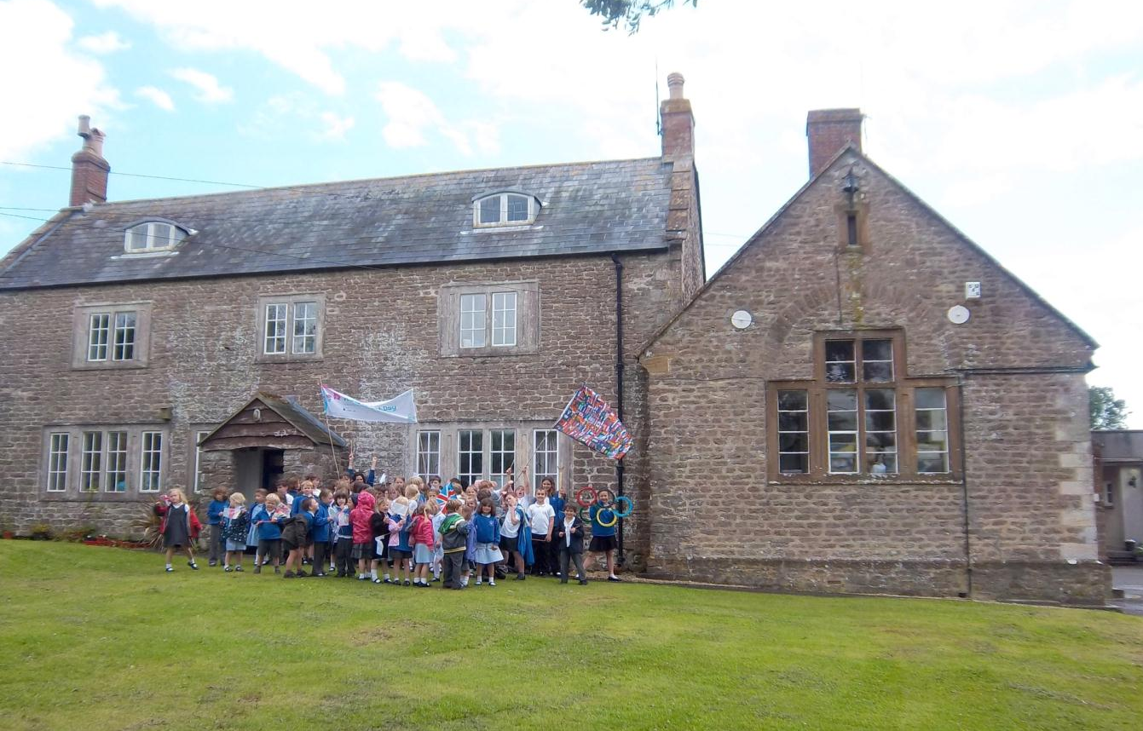




Slide 2
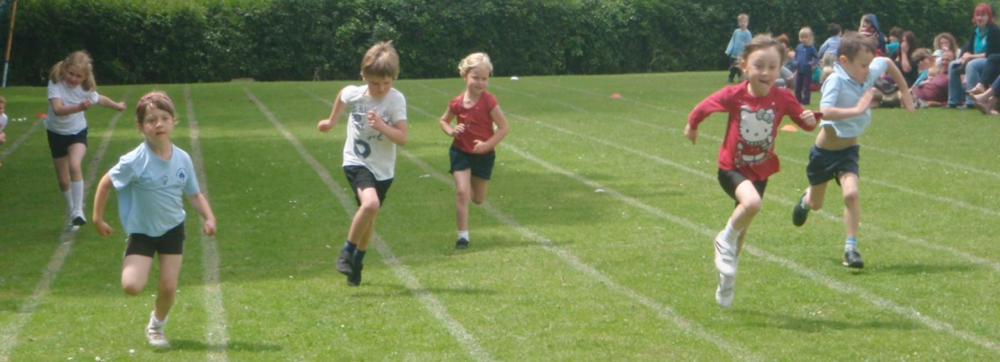
“Pupils and staff show high levels of respect for each other. This ensures a happy, welcoming and harmonious school where pupils enjoy learning.”
“Behaviour is good, both in and out of lessons, because the school promotes pupils’ personal development exceptionally well throughout its curriculum.”
Ofsted
We aspire to develop Christian values in our communal life by providing a happy, caring and challenging learning environment.

Slide 3
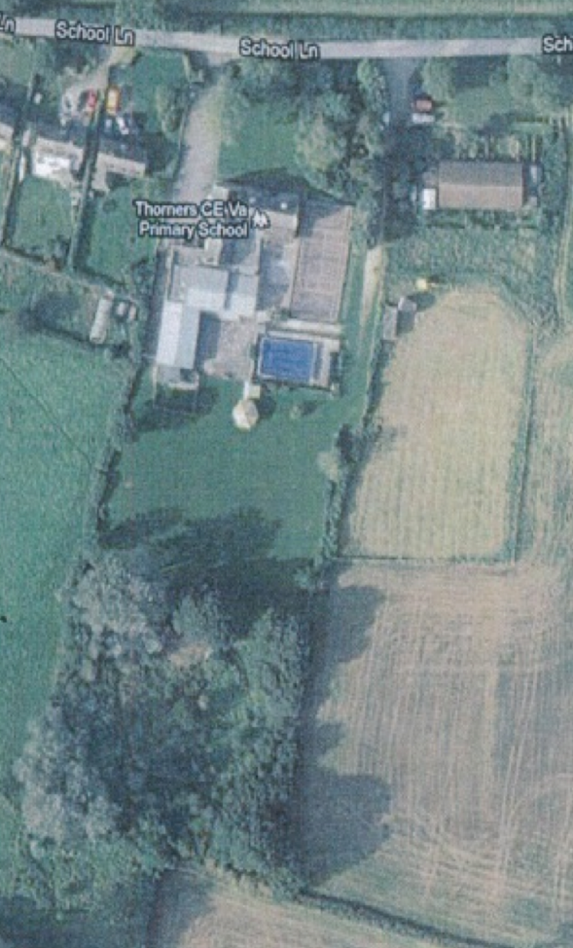
Dear Parents,
I warmly welcome you and thank you for your interest in Thorner’s Church of England Voluntary Aided Primary School. I hope that this prospectus gives you a flavour of what makes us special.
Thorner’s is a small school and, as a result, staff are able to build close working relationships with the children and their parents. We understand that every child is different and has unique skills, talents and interests. We know that children learn at different rates and have different needs. We take the time to understand each child’s character and learning style. Through all of this we aim to work with every child as an individual, helping them to understand and achieve their full potential.
The school’s Church of England status is important to us all, and Christian values are central to daily life at Thorner’s. Part of this ethos is equality for all. Our school values all members of the community. We promote positive attitudes towards life in a multicultural, multi-ethnic and multi-faith society and ensure that all pupils, regardless of their background or beliefs, are equally respected and offered the same opportunities to achieve.
At Thorner’s we are also fortunate to benefit from a truly stunning setting with plenty of outside space and facilities beyond our modest size.
Thorner’s is a very happy place where children can develop lasting friendships, confidence and a positive attitude towards education. I personally feel incredibly proud of this school - our staff, our pupils, our facilities and our very supportive parents and community.
You can find out more and see what the children have been doing by visiting the school website: www.thorners.dorset.sch.uk. Better still, visit us in person. I would love to show you around and introduce you to the staff and children.
I look forward to meeting you.
Yours sincerely,
Jyotsna Chaffey

Slide 4
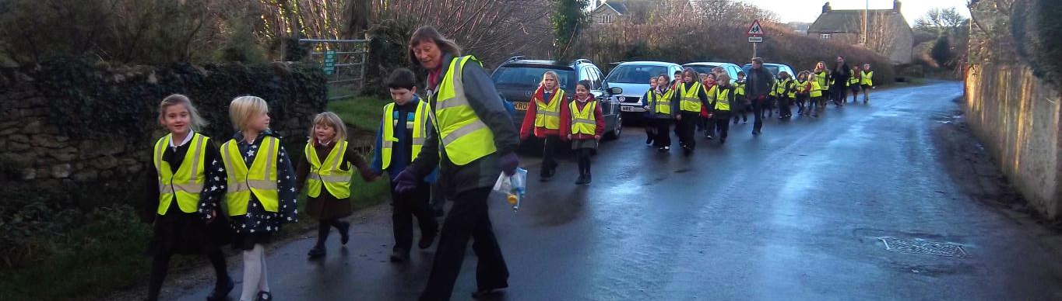
THE FACTS
Size:
We currently have 75 pupils ranging in age from 4 to11 years. We have mixed age classes with small numbers in each. Children are organised into four classes: Reception; Years 1 and 2; Years 3 and 4; and Years 5 and 6. We have a thriving pre-school – Fledglings - which is open daily. It takes children from the age of 2 years 9 months and prepares them for life at school.
Location:
Thorner’s is located in the village of Litton Cheney in the beautiful Bride Valley between Bridport and Dorchester. The school serves the nearby villages as well as attracting families from a wider area. Our rural situation is a real asset with plenty of outside space, frequent opportunities to walk around the village and far reaching views from our hall and sports field.
History:
Our school is one of the oldest surviving schools in Dorset and was founded in 1690 by Robert Thorner to benefit the boys within the mainly farming village. Today the school has been extended and developed to accommodate the increasing numbers of pupils and our changing needs. But the original building remains at the heart of the school and Thorner’s has maintained strong active links with the valley churches and the local community whose help and support has been responsible for a large part of the school’s development.
Approach:
Our aim is to help each child fulfil his or her potential academically, spiritually, intellectually, emotionally, creatively and physically. We have a happy environment with well-qualified and experienced staff. We use praise and encouragement to ensure academic progress and achievement. We provide a wide and balanced range of opportunities and encourage children to ‘have a go’ at everything they are offered.
Achievements:
We are very pleased with our latest Ofsted and church inspections. Both reports can be viewed via our website.
On a day-to-day basis we acknowledge and celebrate individual achievement including acts of kindness, effort and success in the classroom. Each class has a system of rewards, there is a weekly Headteacher award and half termly thank you prizes. We hold termly Celebration Assemblies to which family and friends are invited. Pupils are encouraged to share work they are proud of with the rest of the school.

Slide 5
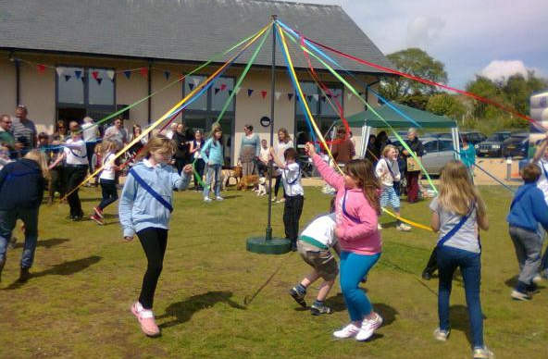
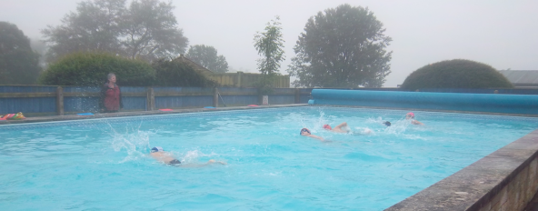
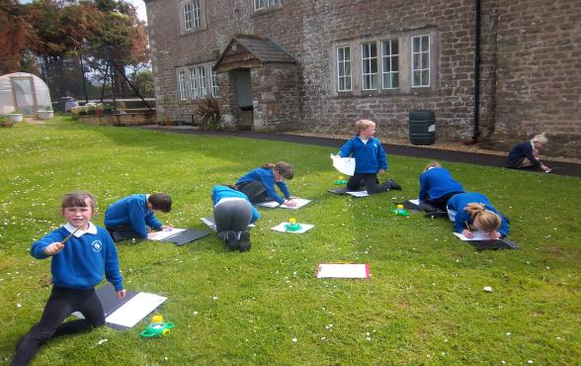
FACILITIES AND ENVIRONMENT
LATCH (Litton and Thorner’s Community Hall):
In 2009 a new hall was built adjacent to the school grounds. The hall is a joint project between Thorner’s and the Litton Cheney village. It is a great asset to the school. We hold our daily assemblies here, hot lunches are served from the kitchen, the hall is stocked and fitted with indoor gym equipment for our PE, and school and visiting productions are regularly performed on the stage. Parents use the hall car park for safe pick up and drop off before and after school.
Outdoor sports facilities:
At Thorner’s we are very fortunate to benefit from a great deal of outside space. We make a point of getting out of the classroom and into the fresh air as much as possible. We have a large sports field for football, cricket, rounders and other team sports; this is also where the children play at break times. We have a hard tennis/netball court, a mini putting green and a heated outdoor swimming pool which is used during the summer term.
Discovery Area:
Until a few years ago, an area of about one acre of the school grounds had been completely overgrown with brambles and nettles. A highly motivated group of parents, inspired by the forest school concept, took it upon themselves to develop this area into an educational discovery area. It has been a lot of hard work – in which the children have been involved – and there is still a way to go. But today the area boasts fruit trees, vegetable patches, a wildlife pond with a pond dipping platform, a willow storytelling dome and an outside classroom area. Our most recent project was the building of a Saxon hut. We love working out here and we try to utilise it for a range of curricular and extra-curricular activities as much as the weather will allow us.
Library:
The opening of LATCH freed up a significant amount of space in the original school building and we have been able to create a library area. The children are encouraged to visit it frequently and can borrow books every week to take home.

Slide 6
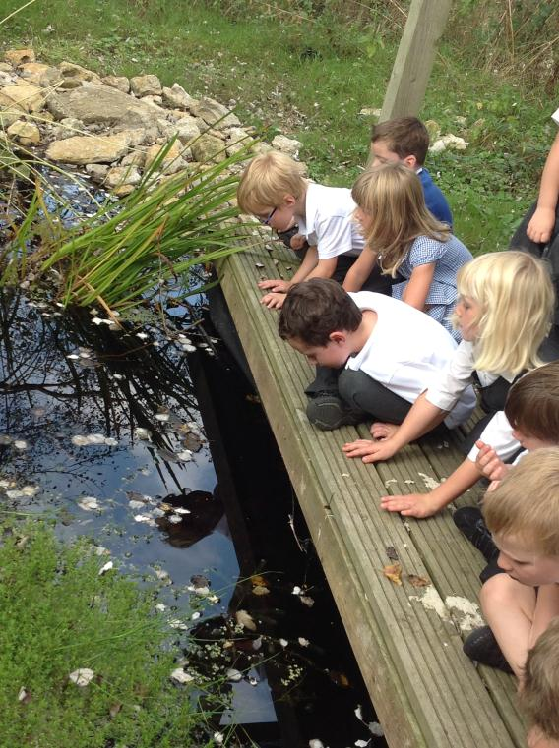
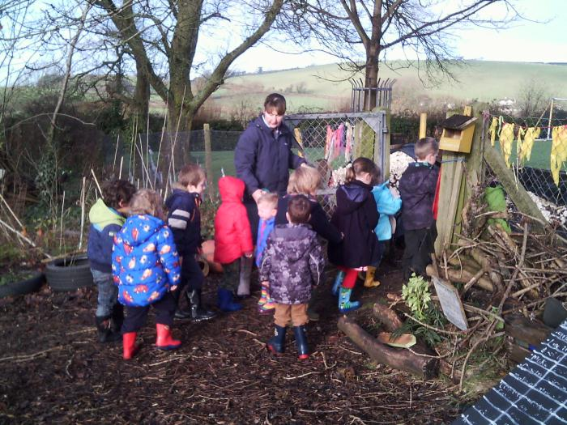
FACILITIES AND ENVIRONMENT
Fledglings Pre-School:
Our pre-school is open daily for children from the age of two years nine months. The facility is part of the main school but has its own separate entrance and outside play area. This enables the children to feel secure in their own small and familiar environment whilst still having access to the gym, hall and outside facilities of the school. Fledglings can care for a maximum of 20 children at any one time, but group sizes vary between sessions and the relatively small groups ensure that the pre-school team can spend time with each child individually. Frequent outings and activities are also possible. The Fledglings are often seen working in their wellies in the school’s Discovery Area or venturing further afield on a ‘rope walk’ around the village.

Slide 7
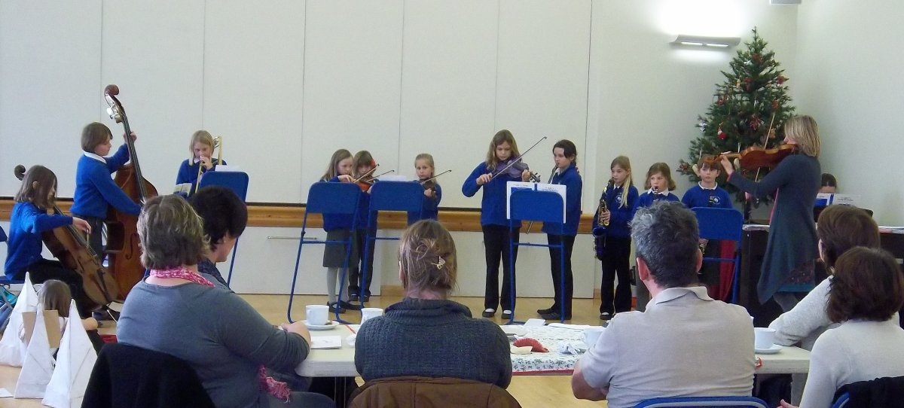
IN THE CLASSROOM
Class structure:
The school is divided into four classes. Litton is for the reception children who are based in their own area within the Fledglings pre-school. This allows the younger children easy access to the pre-school ‘learning through play’ equipment. It also provides a quiet space away from the hustle and bustle of the main school.
Our other three classes - Chesil, Bredy and Eggardon - each span two year groups. As well as being necessary due to the small size of the school, we feel it gives the children more opportunity to learn at their own pace. For core subjects such as English and mathematics the children are divided into smaller groups according to their ability rather than their age. Older and more mature pupils from each year group are able to mix in with children from the year above; younger children or those who may be struggling in certain areas have the opportunity to repeat key learning from the previous year.
Staff:
The school is led and managed on a day-to-day basis by Head Teacher Mrs Chaffey, supported by Marion, our super efficient Secretary.
In the classroom, talented and creative professional teaching staff take responsibility for leading and inspiring pupils in particular aspects of the curriculum. Mrs Williams, in Litton (Reception), is responsible for overseeing the children’s progress in Geography and RE. Miss Smith in Chesil (Years 1 and 2) leads Science and Music. In Bredy (Years 3 and 4) Mrs Marshall is our English expert, as well as leading history, MFL and art, and Miss Newbury oversees ICT and Design & Technology. In Eggardon (Years 5 and 6) Mr Sitch organises PE and is also our SENDCO (special needs) expert. Mrs Chaffey is our numeracy and PSHE champion.
A team of highly dedicated Teaching Assistants are deployed throughout the school to support teachers on a day-to-day basis in the classroom. They also offer additional help to those pupils who have special educational needs. Higher Level Teaching Assistants may, at times, take responsibility for classes to allow staff time for planning, preparation and assessment.

Slide 8
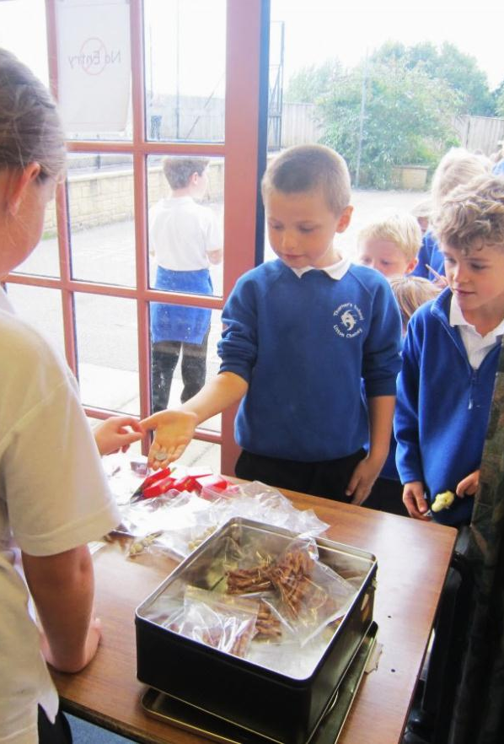
IN THE CLASSROOM
The School Day:
The school day at Thorner’s officially begins at 9am and ends at 3.30pm. Healthy hot lunches are prepared daily in partnership with Dorset Local Food Links who source many of their ingredients from local suppliers. Children may also bring packed lunches.
A daily breakfast club is offered in school from 8am. A delicious hot breakfast is served to the children, many of whom attend by choice rather than necessity.
Other clubs, which take place at lunchtimes and some after school, are organised by staff, parents and local volunteers. They vary depending on the term, but currently include an art/Forest School club, an eco club and a gardening club, a homework club, cooking and seasonal sports.
If you have a skill that you would like to pass on to others and the time to commit on a regular basis please come and talk to us as we are always seeking to expand the range of our clubs.
Curriculum:
We provide a broad and balanced curriculum with opportunities for group work and class work. Competence in the basics of number, phonics and writing receives high priority throughout the school. If a child requires additional attention we provide individual or small group support.
The National Curriculum and the Early Years Foundation Stage documents guide staff in the activities we offer our children. We aim to keep up to date with national developments and provide opportunities for teaching and learning at aspirational standards.
In a school of this size each child will spend more than one year in each class. Much effort goes into the planning of each term’s activities to provide children of all ages and abilities with a suitably challenging and stimulating programme of work.

Slide 9
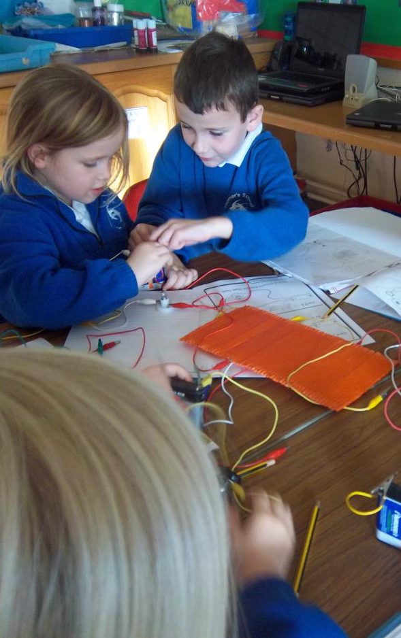
IN THE CLASSROOM
English
Reception age children are taught to read using Letters and Sounds, a proven method that teachers are happy to share with parents. We encourage children to become keen readers allowing them to choose their own books from a large selection within their reading ability. Children take part in guided reading sessions at least once a week and have regular one to one opportunities to read. This ensures all pupils are progressing at an acceptable rate. Big Write takes place weekly or fortnightly – the children write as much or as little as they wish in their own special ’Big Write’ book with no help or guidance from teachers. Big Write is very popular and has produced some really exciting and creative work. As pupils progress through the school more emphasis is put on correct spelling and handwriting. The children also develop their grasp of the English language through examining and experimenting with different writing styles such as report writing, non-fiction and poetry.
Mathematics
We follow the National Curriculum for mathematics. We use ‘Maths No Problem’ and use a variety of resources, including ICT, for calculations and problem solving. Maths is made purposeful and enjoyable by using real life examples such as measuring trees, doing a traffic survey in the village and finding out our favourite pet or fruit.
Presentations for parents explain our specific methods and approaches for teaching English and mathematics. Attendance is voluntary, but parents have reported these sessions as being helpful and informative.
Science
Together with English and maths, science is a core subject. We give children a wide coverage of topics and ensure they have hands-on experience. With this in mind, the school orchestrates science events. This year we brought a science dome into our hall to enable children to learn about space.

Slide 10
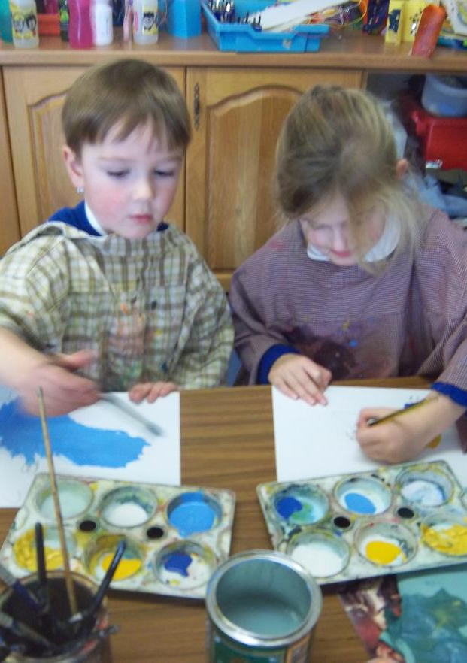
IN THE CLASSROOM
ICT
The school has a bank of laptops and ipads enabling individual or paired work. Each classroom is equipped with an interactive whiteboard for demonstration purposes. We have control gadgets – Beebots – and cameras that the children can use. A visiting specialist teacher enables termly projects with each class such as producing animation films.
Music
Music is strong at Thorner’s and several children perform regularly in school assemblies. More than two-thirds of our children learn a musical instrument, and half have individual lessons. Currently we offer lessons in violin, viola, clarinet, flute, fife, saxophone, keyboard, guitar, ukulele, bass and drums. Bredy and Eggardon have 10 weeks of lessons under the Dorset Music Service Musicianship programme; this year they are leaning brass. Mrs Williams provides free recorder lessons to Year 2.
Art
We use a range of topics to give our children experience of different materials, textures and styles. One of our recent projects has been ‘in the style of Picasso’.
Humanities
We teach history and geography according to the National Curriculum, and cover a wide range of topics to ensure breadth of knowledge. Whenever possible we include field trips to local sites or museums or invite specialists to come into the classroom.
Religious Education
Thorner’s is a Church of England Voluntary Aided School and the study of Christianity forms a large part of the teaching in Religious Education. We also examine and compare other faiths. We follow the Salisbury Diocese Scheme of Work.

Slide 11
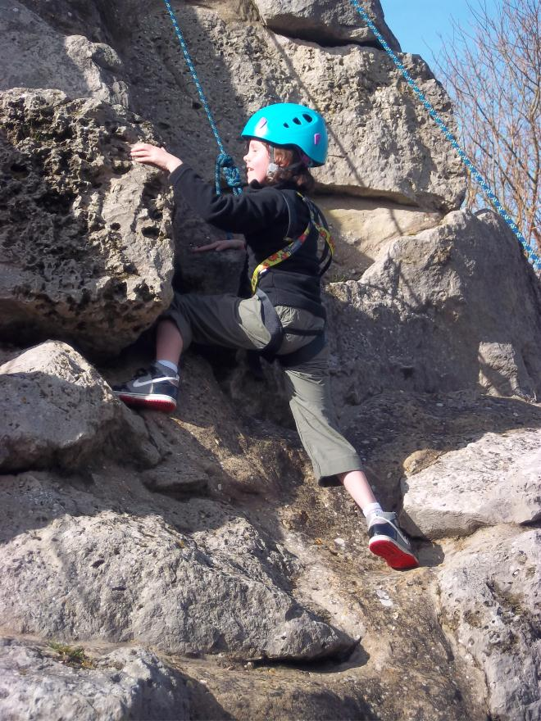
IN THE CLASSROOM
Physical Education
Sport and physical education are greatly encouraged at Thorner’s, not least because of our grounds and superb facilities. Children take part in regular PE lessons as part of the curriculum. Professional coaches come to the school to provide lessons in a range of sports, such as football, rugby, tennis, golf, volleyball, cricket, archery, trampolining and gym. During the summer term we make the most of our heated outdoor pool with daily swimming lessons. We have football, netball, rugby, cricket, tennis and other ‘active’ lunchtime clubs and participate in pyramid, West Dorset and County sports fixtures – football, netball, cross country, cricket, rugby, swimming etc.
Special educational needs and gifted pupils:
At Thorner’s we believe that every child should be given equal opportunity to progress and excel, whatever their level of ability. Some children need special help because they have difficulty with basic literacy and numeracy. Others have needs because of their high level of attainment and ability. A small proportion of pupils have emotional needs while others have physical limitations.
Class teachers use various strategies and also draw upon the experience of visiting Special Educational Needs teachers as well as Educational Psychologists appointed by County. We have adopted a step-by-step approach to managing children with special needs as proposed by the SEND Code of Practice.
We endeavour to work with parents to ensure that ALL children are given the attention they need and remain engaged, challenged, safe and happy throughout their time at Thorner’s.

Slide 12
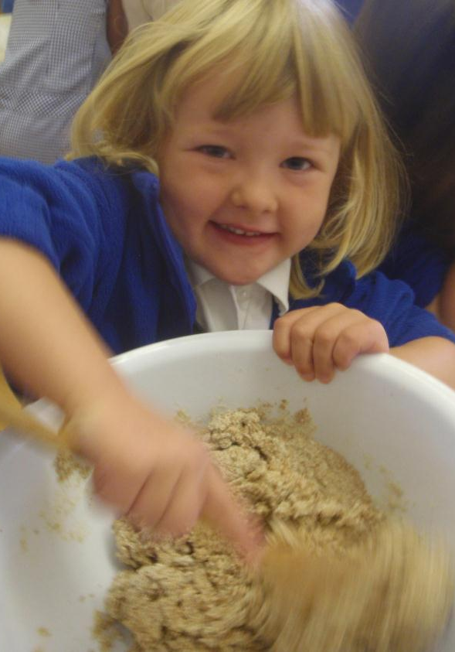
IN THE CLASSROOM
Homework:
All pupils are expected to do some work at home. This will take many forms and will be of varying length depending on age. From Reception, children are given books to take home and read with their parents. As they move up through the school homework becomes broader and more demanding. They may be asked to learn spellings or multiplication tables, undertake reinforcement work in maths or English, to research topics, or to complete unfinished work at home if the teacher feels this is necessary.
Homework is a good opportunity for parents to engage with their children’s learning. It also prepares the pupils for expectations in secondary education.
Contact with Parents and Carers:
We believe the positive role model set by parents complements, supports and contributes towards the education of each child. We like to maintain a close partnership, and include parents in the life of the school on a day-to-day basis. This partnership is based on understanding, mutual respect and working towards the success and achievements of the children. Parents are very welcome to come into school and talk with Mrs Chaffey or the class teachers as they think is necessary to keep informed about the progress of their child.
A regular link with parents and carers is maintained through the daily Home School Contact book in Key Stage 1 (Reception, Years 1 and 2), Homework Diaries in Key Stage 2 (Years 3, 4, 5 and 6) and Reading Records (Reception to Year 4).
Assessment:
Children are continually observed and assessed by their teachers to ensure that they are suitably challenged and achieving positive development. This includes informal tests and discussion. Children in Years 2 and 6 are also assessed using statutory end of key stage tests.
In the Autumn and Spring Terms there is an opportunity for all parents and carers to meet teaching staff to discuss attitudes, progress and achievements. There is also an annual written report for each child in the Summer Term.

Slide 13
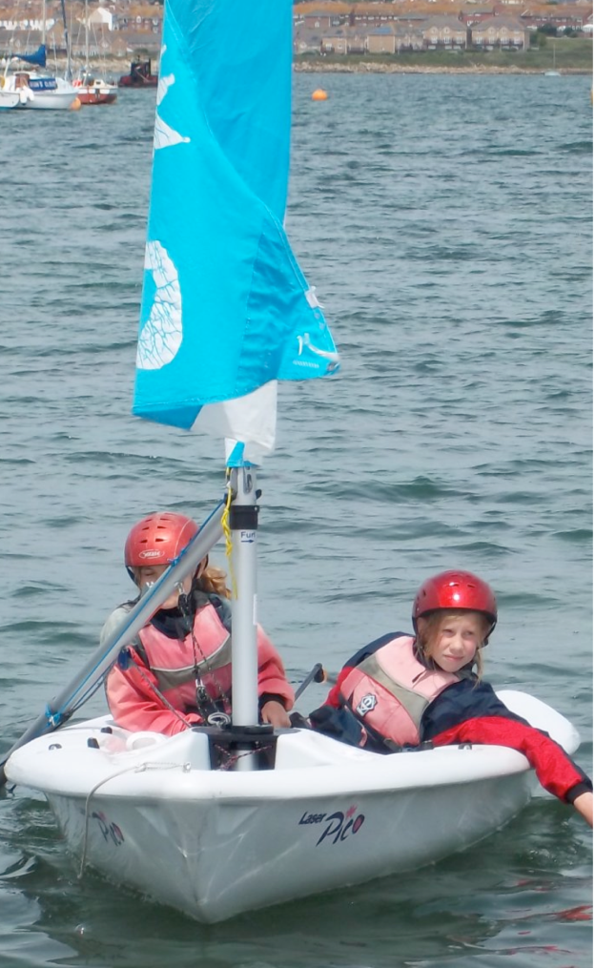
THE WIDER WORLD
Links with church:
Thorner’s is a Church of England school and Christian morals underpin the way we view the world and each other. Every child attends a whole school daily act of worship in the Hall. Teachers take it in turn to lead, and visiting speakers are invited to address the pupils. The Rector of the Bride Valley Team Ministry or one of his representatives leads a weekly assembly. In our assemblies we explore bible stories and characters, as well as moral and ethical issues.
Regular assemblies, at the beginning and end of each term, are held in church. Parents are invited to walk with us or meet us in church. Some services coincide with the major festivals. All children, whether Christian or otherwise, are welcome to attend Thorner’s and are respected for their own beliefs. Parents are entitled to withdraw their child from religious worship and instruction should they wish.
Links with community:
We are fortunate that a number of our parents and grandparents, and other members of our community, regularly offer help, for instance with cooking, managing the Discovery area, supporting Design and Technology and listening to individual children read.
LATCH, used on a daily basis by the school for assemblies, PE, lunches, performances and parking, is the result of a very successful joint venture with the local community.
Links with other schools:
Thorner’s is part of the Bridport pyramid which includes the primary schools of Burton Bradstock, Loders, Powerstock, Symondsbury, St Mary’s Bridport, Bridport Primary and St Catherine’s. We regularly compete with each other in sporting activities and undertake joint ventures. We also have close links with Mountjoy School and the Sir John Colfox School in Bridport.
Since 2016 we are part of the West Dorset Schools Collaboration which comprises seven other primaries from Bridport and Beaminster – Symondsbury, Powerstock, Salway Ash, Broadwindsor, Sticklands, Parrett & Axe and Greenford. This partnership enables us to benefit from extended resources and the pupils to have experience of the wider community.

Slide 14
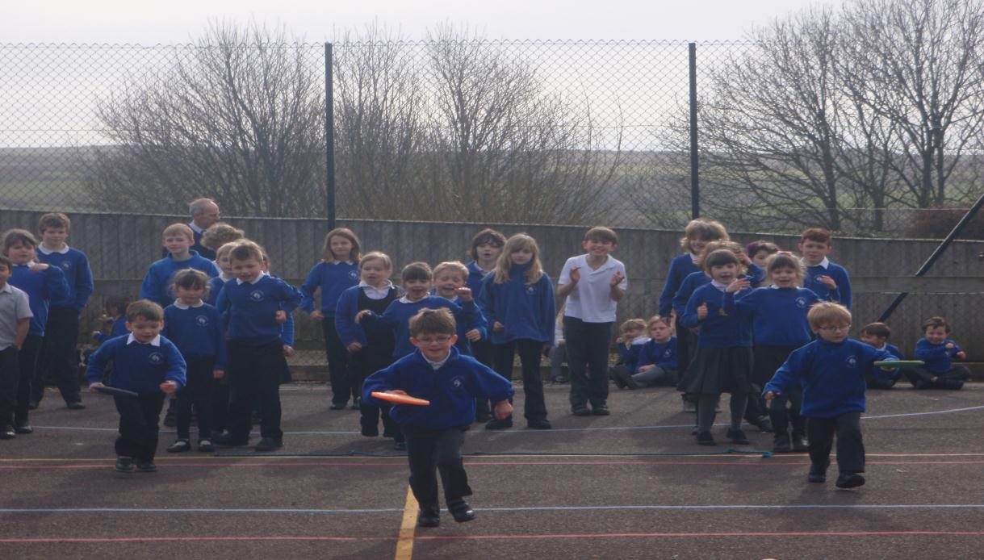
WHERE NEXT?
Most children attending Thorner’s go to Sir John Colfox School for their secondary education. Some of our pupils opt for other secondary schools.
Every opportunity is taken to ease the transition to secondary school. There is a carefully structured induction programme, which starts as children come to the end of year 5. All year 5 pupils are invited to spend a ‘taster’ day at Colfox School during the summer term, working in one of the departments: Science, Technology, Drama or Art.
Year 6 pupils are invited to two Induction Days when they are generally able to meet their tutor and peers.

Slide 15
9:00 | School Day Starts
9:05 – 9:30 | School Assembly
9:30 – 12:00 | Lessons
12:00 – 1:00 | Lunch
1:00 – 3:30 | Lessons
3:30 | School Day Ends
The Timetable
Registration is at 9am and registers close at 9:30am. If a child is late we are required to record this in the school register. Parents are asked to ensure that their child arrives at school no earlier than 8:50am. From that time, staff are available to supervise the children. Please note that parents have sole responsibility for their children before and after school.
Lunches
Hot lunches can be ordered online in advance.
Transport
A County bus is available; please enquire at the school office for details.
Extended School
We have a Breakfast Club before school every day from 8:00 to 8:50, when pupils can enjoy a healthy breakfast, discuss various items of interest, do puzzles, enter competitions and chat to their friends.
Term Dates
During each school year, teachers attend training days. The school is not open for children on these days. The following days are designated training days in the academic year 2017-18:
Monday, 4 September 2017
Tuesday, 2 January 2018
Monday-Wednesday 23-25 July 2018
The academic year 2017-18 will start for children on Tuesday 5 September 2017.
Autumn 2017
Starts: Tuesday 5 September 2017 Half Term: 23 to 27 October 2017 Ends: Friday 15 December 2017
Spring 2018
Starts: Wednesday 3 January 2018 Half Term: 12 to 16 February 2018 Ends: Thursday 29 March 2018
Summer 2018
Starts: Monday 16 April 2018 Half Term: 28 May to 1 June 2018 Ends: Friday 20 July 2018

Slide 16
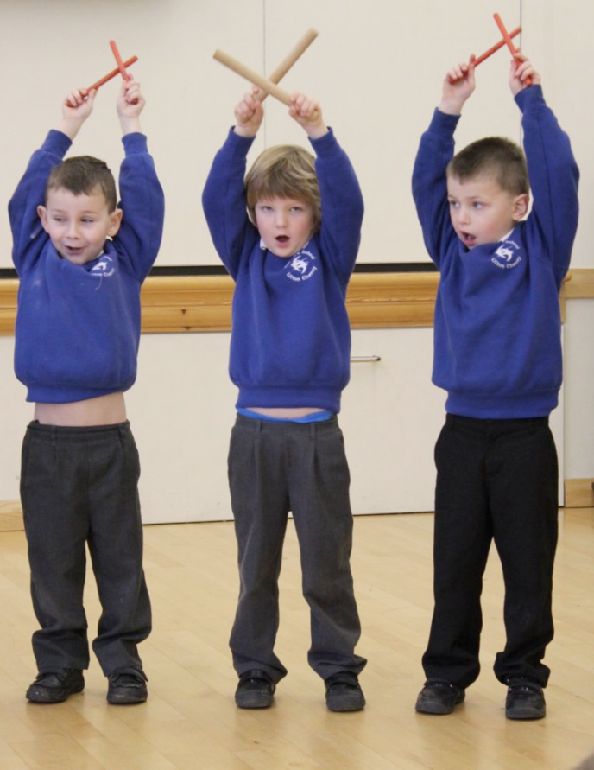
Uniform
School sweat shirt or fleece (available from the school office)
Grey or black trousers, skirt or dress
White shirt or polo shirt
Blue gingham dress (optional for girls in summer)
Black shoes
Plain black, grey or white socks or tights
PE/Games kit
School t–shirt (available from the school office) or white t-shirt
Black, navy or white shorts
Football boots (optional)
One piece swim suit, swimming hat and towel (for summer term)
Jewellery should not be worn with the exception of stud earrings. Long hair should be tied back.
We ask that all school clothing should be clearly marked with the child’s name.
WE LOOK FORWARD TO MEETING YOU.

